Slide 1
Question 3
Submitted by Jamil Rayhan
ID: 18CSE061

Slide 2

Question
Implementation of the following Boolean function with one 4x1 multiplexer and external gates.
F(A,B,C,D)=$\sum{(1,3,4,11,12,13,14,15)}$

Slide 3
Truth Table
A | B | C | D | F
0 | 0 | 0 | 0 | 0
0 | 0 | 0 | 1 | 1
0 | 0 | 1 | 0 | 0
0 | 0 | 1 | 1 | 1
0 | 1 | 0 | 0 | 1
0 | 1 | 0 | 1 | 0
0 | 1 | 1 | 0 | 0
0 | 1 | 1 | 1 | 0
1 | 0 | 0 | 0 | 0
1 | 0 | 0 | 1 | 0
1 | 0 | 1 | 0 | 0
1 | 0 | 1 | 1 | 1
1 | 1 | 0 | 0 | 1
1 | 1 | 0 | 1 | 1
1 | 1 | 1 | 0 | 1
1 | 1 | 1 | 1 | 1
AB=00
F=D
It is to find out the input output relationship
AB=01
F=C’D’
=(C+D)’
AB=10
F=CD
AB=11
F=1

Slide 4
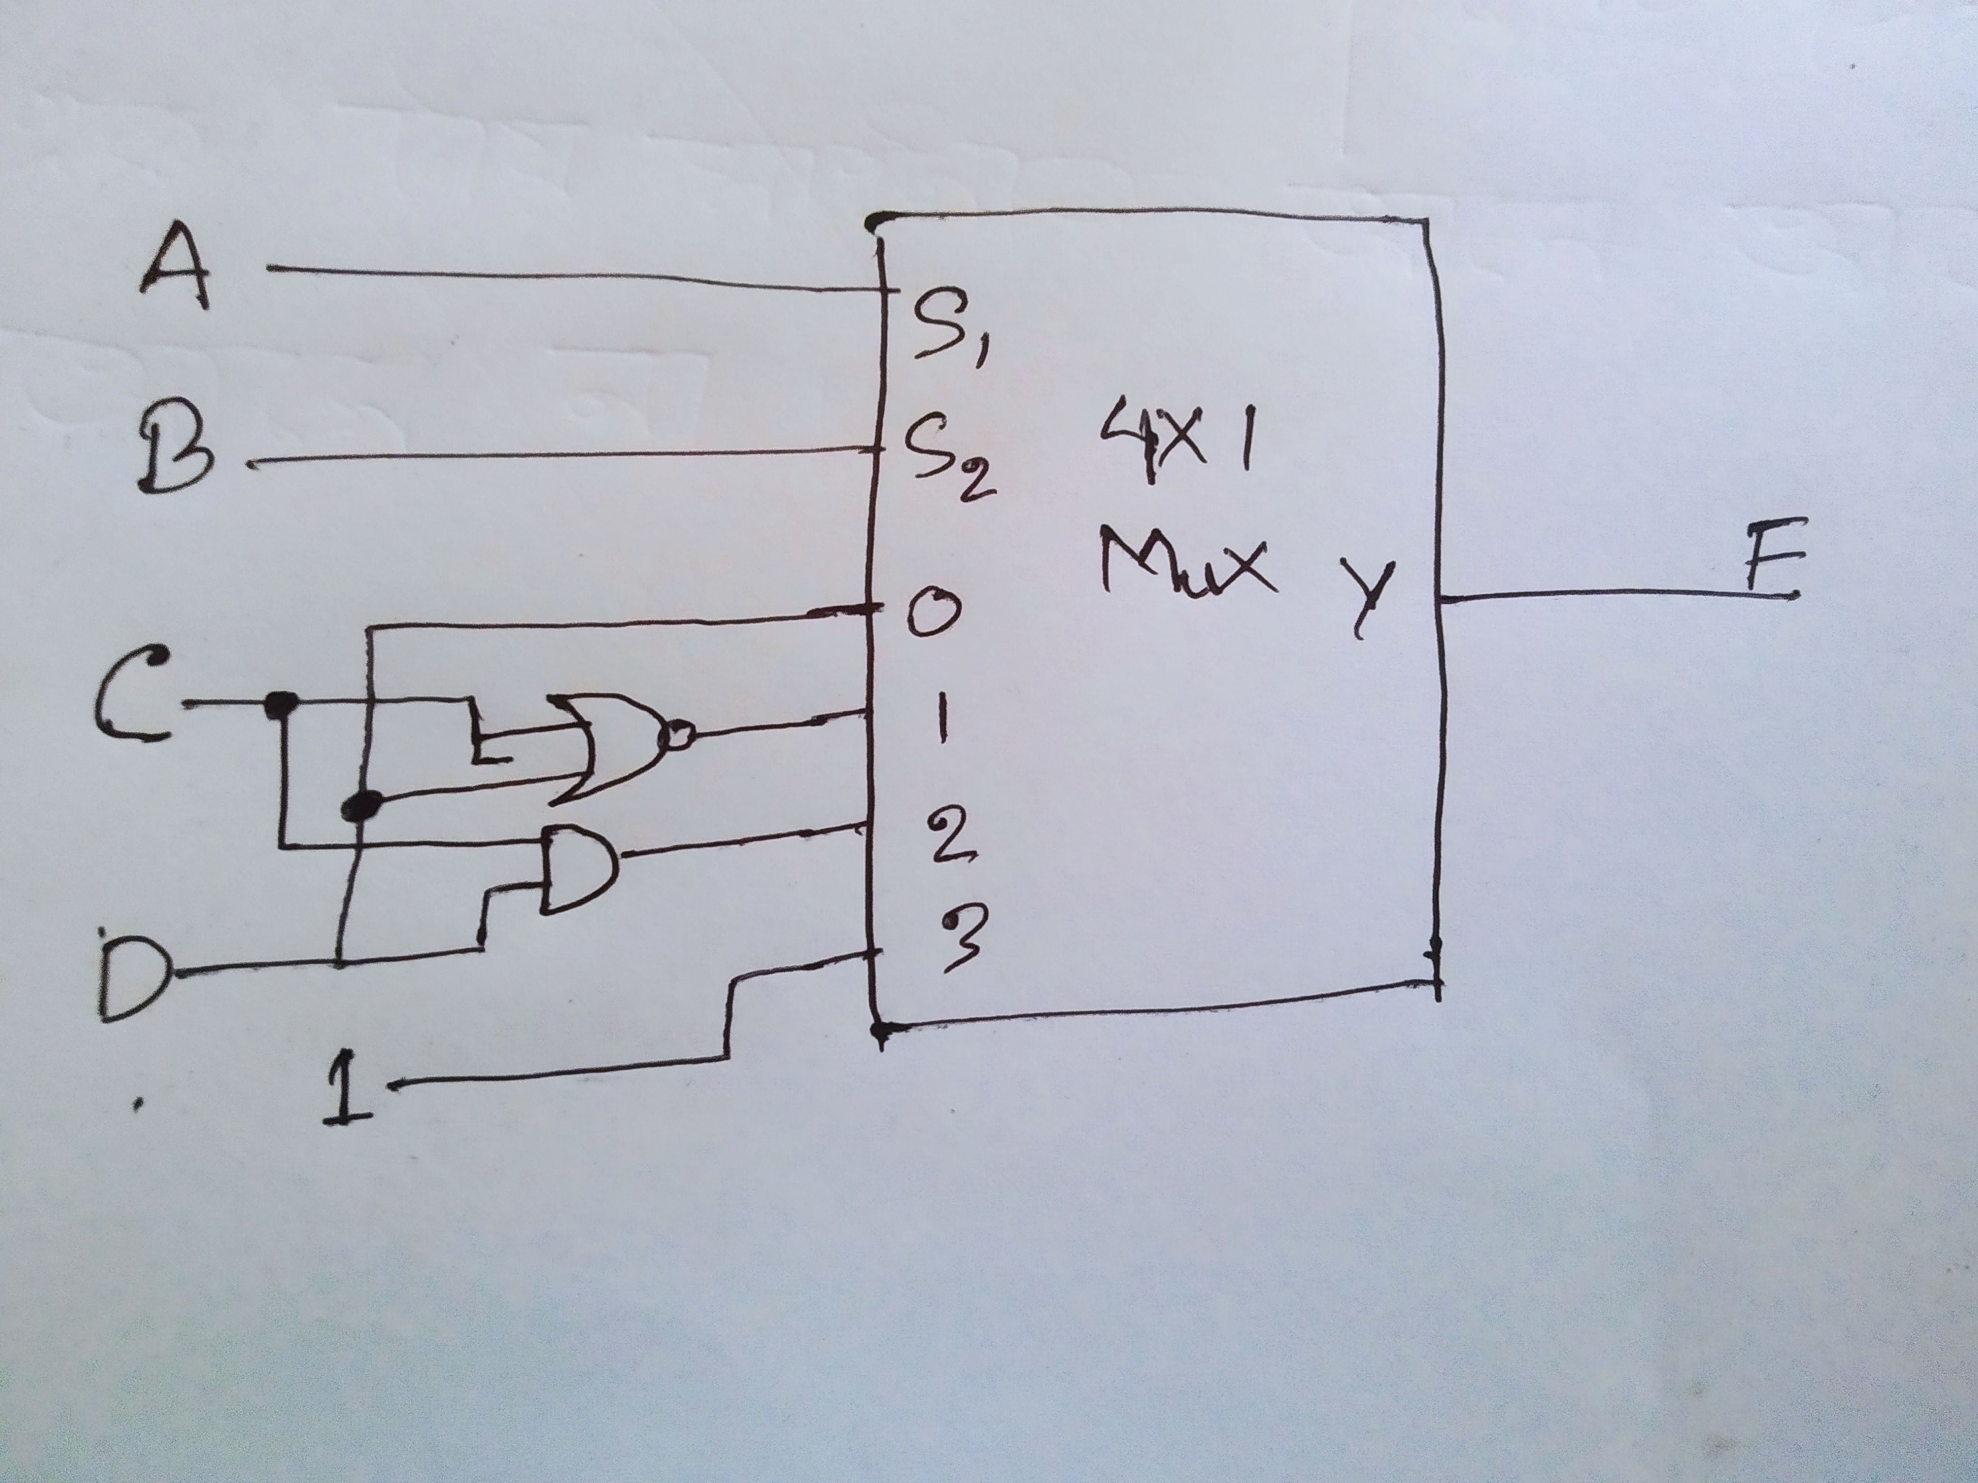
Circuit Diagram

Slide 5
Thank You

